Slide 1

RUST: An Introduction
Written and presented by:
Jeremy Stevens & Anthony Loughlin

Slide 2

First Meet Ferris, The Crab
Hello friends, glad to see your interested in my favorite language, rust! The three of us will help give you a basic understanding of why this language is great!

Slide 3

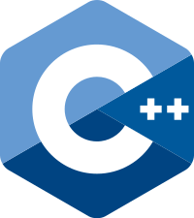

What is Rust?
General Purpose
Wide variety of uses
Low-Level Programming language
Systems Language
Syntactically similar to C++
But much safer!

Slide 4

A brief history
Developed by Mozilla
Relatively new language
Originally created July 7^{th, 2010}
First numbered pre alpha release in January 2012
First stable release May 15th, 2015
According to stack overflow popularity polls
2015: 3rd most beloved language
2016-2019: 1st most beloved language

Slide 5

Why Rust?
Incredibly fast, powerful, safe
Emphasizing how safely and efficiently it handles concurrency
Portable
No Garbage collection/memory management
Game Development

Slide 6

No garbage collection? How?
One of rusts biggest advantages
In comparison to C and C++
Automated
Removes tedious work
Compiler takes care of it !
Finds unused variables and disposes of them to free up memory

Slide 7


Web development ?
Webassembly(WASM)
Designed to work alongside JS
Compared to Ruby or flask
Shows potential, not quite there yet
We’ll get there someday though, I just know it!!

Slide 8

Safety First !
Why rust is safer than other languages?
Rust is completely memory safe!
Checking at compile time that eliminates large classes of programming errors
The rust compiler does the checking for you and finds whether you’ve made any of these mistakes
This allows you to be confident that you haven’t overlooked these errors

Slide 9

What is Cargo?
Cargo is Rust’s build system and Package manager
Cargo handles
Building your code
Downloading libraries
Building those libraries

Slide 10
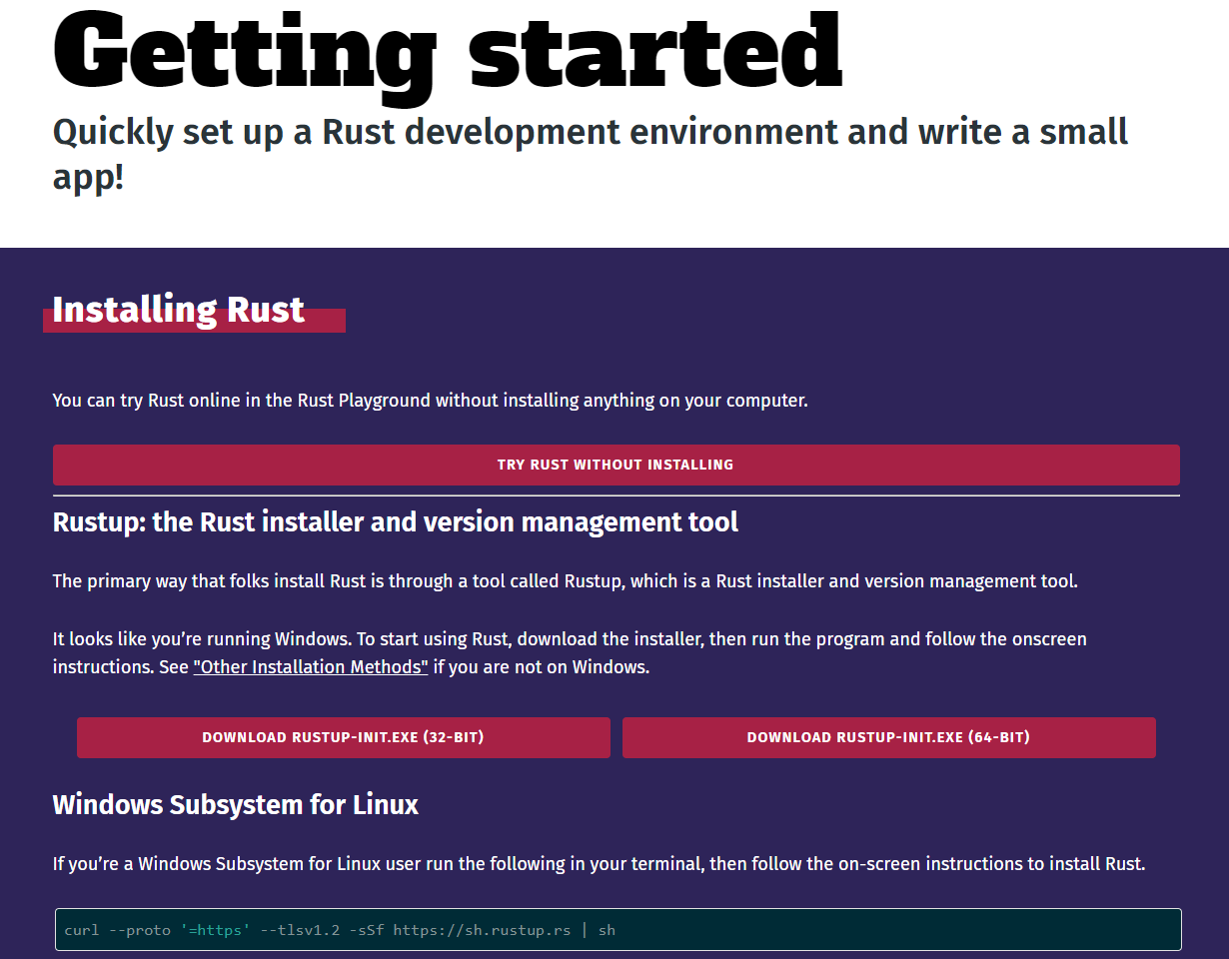
Installation Process
Go to https://www.rust-lang.org/learn/get-started
Follow the steps necessary for your computer’s OS
If not already installed, we also need to download visual studio build tools
Specifically we want the c/c++ build tools you can find them there
You can get them here https://visualstudio.microsoft.com/downloads/#build-tools-for-visual-studio-2019

Slide 11
Versioning console commands
To check version:
To check for updates:
To check compiler version:
To check cargo version:

Slide 12
Let’s set up our VS Code before we begin!

Slide 13
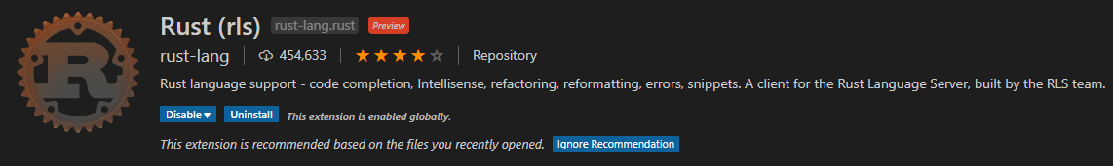

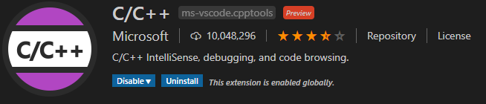
Some Useful extensions
Before we get started we recommend getting the following extensions:

Slide 14
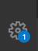
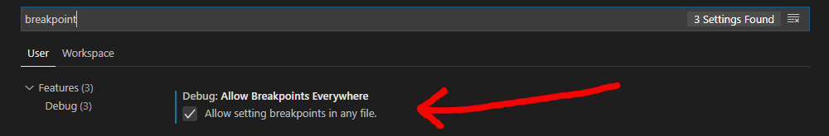
Breakpoint Setup
Using the c/c++ extension we can add breakpoints to our rust project
Go to the cog in the bottom left corner of vs code
Click settings then search breakpoint then check “Allow breakpoints everywhere”

Slide 15
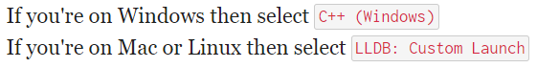
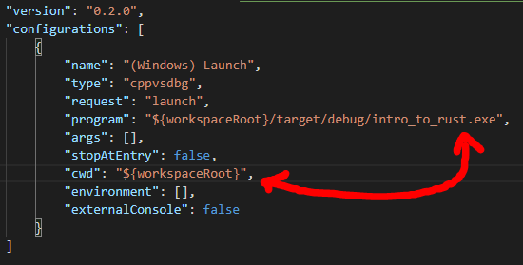
Breakpoint Setup
Go to the debug tab and choose the following based on OS:
Change the following in the launch.json file we want to execute. For me this is what it looks like:

Slide 16
Let's create a new project in VS Code!

Slide 17


A Quick Note on Naming
Most everything in rust uses snake case
This includes the project name
Make sure to remember because rust will throw lots of warnings otherwise
Lets call the project intro_to_rust
Snakes freak me out… but I guess I’m alright with snake case!

Slide 18
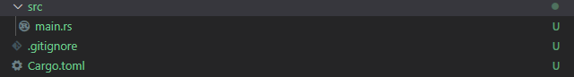
Getting Started
After making our project the first thing we want to do is initialize cargo
Open the command line and input the following:
You should see this these files appear:

Slide 19
Getting Started
Next we want to build the application
To do this we want to use the command:
This should add the target folder to your list of files
Lets look at that now!

Slide 20
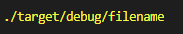
Getting Started
Upon opening the target folder you should see a folder named debug
Open that and you should see an executable file
If you are following along its would be named intro_to_rust.exe
Now we want to run that executable, you can do so by entering the command:
If done correctly “Hello World!” Should be printed in the console!
Congratulations, you just made your first Rust application!

Slide 21
That’s it, thanks for listening!
Just kidding!

Slide 22

Getting Started
We can do these steps much more efficiently with a single command!
To both build and compile we can use the command:
This should print the same result!
Two commands for the price of one? What's not to love?! Thanks Cargo!

Slide 23
Additional Cargo Commands
Release compile: `$ cargo build --release`
This command will create an executable in target/release instead of target/debug.
Makes code run faster at the cost of increased compile time
Check if compilable: `$ cargo check`
Cargo check is much faster than cargo build
Skips the step of producing an executable
Useful when continually checking your work while writing the code

Slide 24

Getting Started
Now that we know how to compile, lets get coding!
In the source folder make a new file, ill call it basics.rs
In this file we will play with functions, variables and a bit of formatting
Lets start by declaring a function!
Alternatively you can just work using your main.rs file, just follow the steps and we will explain!

Slide 25
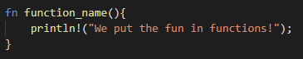
Functions
How to declare a function:
Declare using the fn keyword
Naming convention is snake case
Ex:

Slide 26
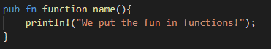
Functions
By default everything is rust is private
In order to access this function on our main.rs file we will need to make our method public
Do this by adding the pub keyword
Ex:

Slide 27
Calling Functions
Now that we’ve written our first function we need to call it
Navigate back to the main.rs file
We now need to give it access to our basics.rs file
To include a module from another file you want to use the following syntax:

Slide 28
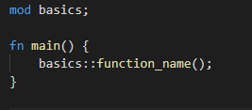
Calling Functions
Now that we have the reference he can access that files functions
Lets replace the println! in fn main() with the following code:
Run the project and you should see our message displayed!

Slide 29
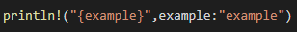
String Formatting
A quick look at some of the ways to format strings in rust
Ex:
Basic Formatting:
Formatting with Positional Arguments:
Formatting with Named Arguments:

Slide 30

Variables
Now let's look at variables
A few notes about variables:
Naming convention is snake case
They hold primitive data or references to data
They are immutable by default
They are statically typed
Known at compile time instead of runtime
They have type inference
With a few exceptions
This seems like a lot of information, but you’ll remember it better once you see it for yourself!!

Slide 31
Variables
Using different keywords:
Standard variable
Use keyword “let”
Ex:
Mutable Variable
Add keyword “mut”
Ex:
Static Variables:
Use keyword “static”
Ex:

Slide 32
Variables
You can assign multiple variables at a time
Ex:

Slide 33
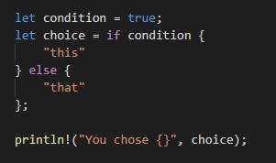
IF Expressions
Ifs preform much like most other languages we’ve worked with in the past
However they are different in the fact that they aren’t statements they are actually expressions.
Rust is primarily an expression language
Expressions can typically nest inside other expressions.

Slide 34
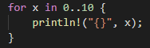
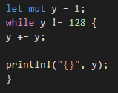

Loops
Rust has a few different types of loops most notably:
For loops:
While loops:
Nothing revolutionary, but infinitely useful.

Slide 35
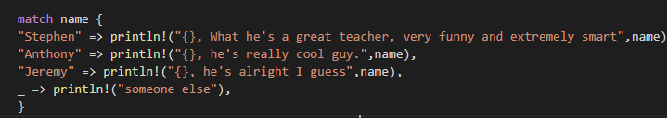
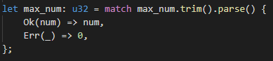
Match
Rust provides pattern matching via the match keyword
Acts like a switch statement:
You can even use it like validation:

Slide 36

Packages and Crate
A Rust Crate is binary or library
Packages are one or more crates that provide a set of functionality
We use packages and crates to provide added or improved functionality to our programs
https://crates.io/ is a great resource for finding crates
Crates add so much cool functionality to Rust, and its all thanks to the super amazing rust community!!

Slide 37
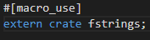
Using Crates
To use an external crate you need to specify the crate in the Cargo.toml under `[dependencies]`
Then run `$cargo build` to add the dependencies to your project.
To implement them for in your program you can then call it with a use statement
Certain crates require other code to be implemented however
Ex:

Slide 38
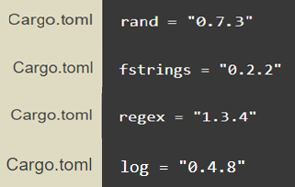
Crate Examples
There are lots of useful crates for example:
Using the rand crate we can generate random numbers
Using the fstrings crate we can do string interpolation with variables
Using the regex crate we can parse, compile, and execute regular expressions
Using the log crate we gain access to a logging api that abstracts over the original logging implementation.

Slide 39

Ownership
Rust most unique feature
Enables rust to make memory safe guarantees without a garbage collector!
3 rules of ownership:
Each value has a variable that’s called its owner
There can only be one owner at a time
When the value goes out of scope it gets dropped
Jeremy has a lot to say on ownership so he’ll go into more detail!

Slide 40
Borrowing
We don’t always want to be passing around ownership that’s where borrowing comes in handy
You can assign read only access using an & in front of your variable name
You can make mutable references but they have restrictions
You are only allowed one mutable reference to a particular piece of data in a particular scope.

Slide 41

Thanks For Listening!

Slide 42
Now for my favorite part…The exercise!!!!

